Slide 1
Introduction to Object Modeling
Object-oriented analysis (OOA) – an approach used to
  study existing objects to see if they can be reused or adapted for new uses
  define new or modified objects that will be combined with existing objects into a useful business computing application
Object modeling – a technique for identifying objects within the systems environment and the relationships between those objects.

Slide 2
Introduction to the UML
Unified Modeling Language (UML) – a set of modeling conventions that is used to specify or describe a software system in terms of objects.
    The UML does not prescribe a method for developing systems—only a notation that is now widely accepted as a standard for object modeling.

Slide 3
Objects & Attributes
Object – something that is or is capable of being seen, touched, or otherwise sensed, and about which users store data and associate behavior.
  Person, place, thing, or event
  Employee, customer, instructor, student
  Warehouse, office, building, room
  Product, vehicle, computer, videotape
Attribute – the data that represent characteristics of interest about an object.

Slide 4
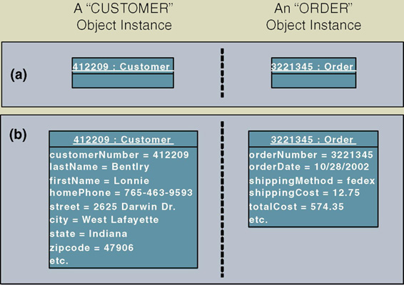
Objects & Object Instances
Object instance – each specific person, place, thing, or event, as well as the values for the attributes of that object.

Slide 5
Behavior & Encapsulation
Behavior – the set of things that the object can do that correspond to functions that act on the object’s data (or attributes).
  In object-oriented circles, an object’s behavior is commonly referred to as a method, operation, or service.
Encapsulation – the packaging of several items together into one unit.

Slide 6
Object Classes
Object Class – a set of objects that share common attributes and behavior. Sometimes referred to as a class.

Slide 7
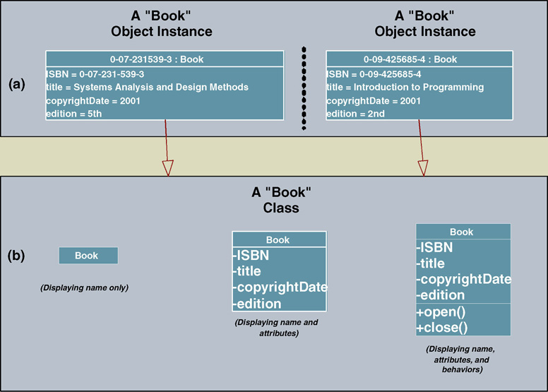
Representing Object Classes in the UML

Slide 8
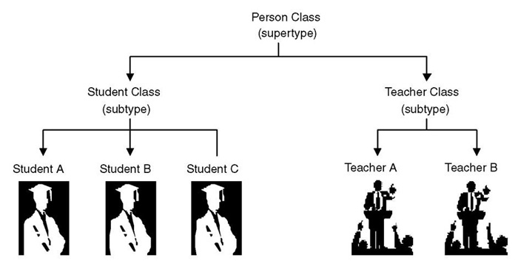
Inheritance
Inheritance – the concept wherein methods and/or attributes defined in an object class can be inherited or reused by another object class.

Slide 9
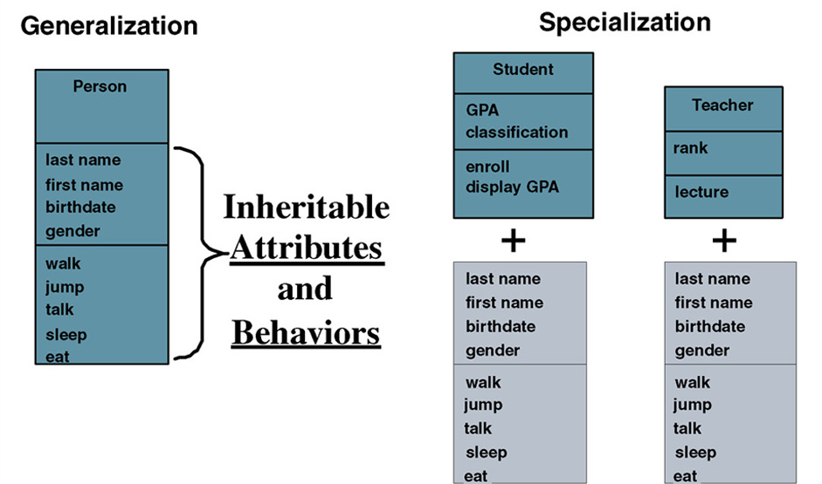
Inheritance (cont.)

Slide 10
Generalization/Specialization, Supertype, and Subtype
Generalization/specialization – technique wherein attributes and behaviors common to several types of object classes are grouped (or abstracted) into their own class, called a supertype.
Supertype – an entity that contains attributes and behaviors that are common to one or more class subtypes. Also referred to as abstract or parent class.
Subtype – an object class that inherits attributes and behaviors from a supertype class and may contain other attributes and behaviors unique to it. Also referred to as a child class and, if it exists at the lowest level of the inheritance hierarchy, as concrete class.

Slide 11
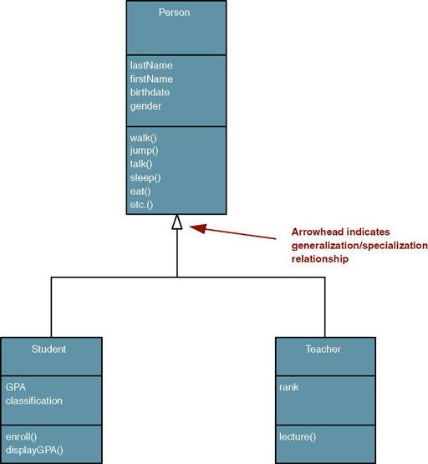
UML Representation of Generalization/Specialization

Slide 12
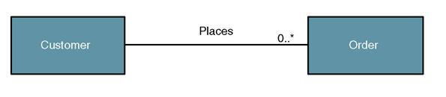
Object/Class Relationships
Object/class relationship – a natural business association that exists between one or more objects and classes.

Slide 13
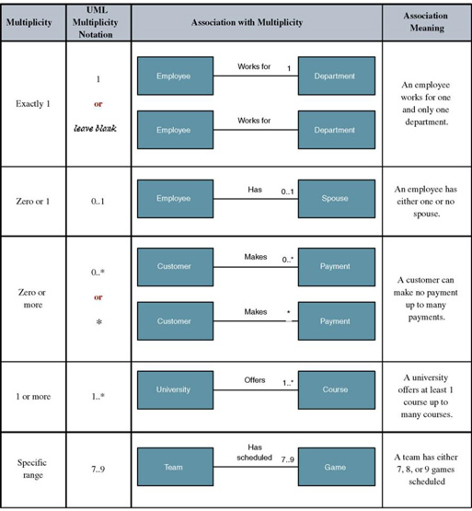
UML Multiplicity Notations
Multiplicity – the minimum and maximum number of occurrences of one object/class for a single occurrence of the related object/class.

Slide 14
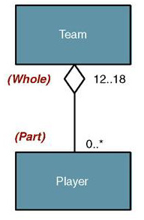
Aggregation
Aggregation – a relationship in which one larger “whole” class contains one or more smaller “parts” classes. Conversely, a smaller “part” class is part of a “whole” larger class
  In UML 2.0 the notation for aggregation has been dropped

Slide 15
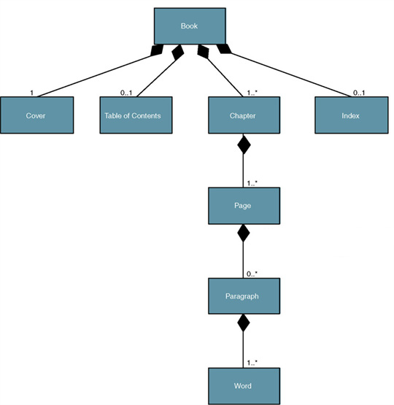
Composition
Composition – an aggregation relationship in which the “whole” is responsible for the creation and destruction of its “parts.” If the “whole” were to die, the “part” would die with it.

Slide 16
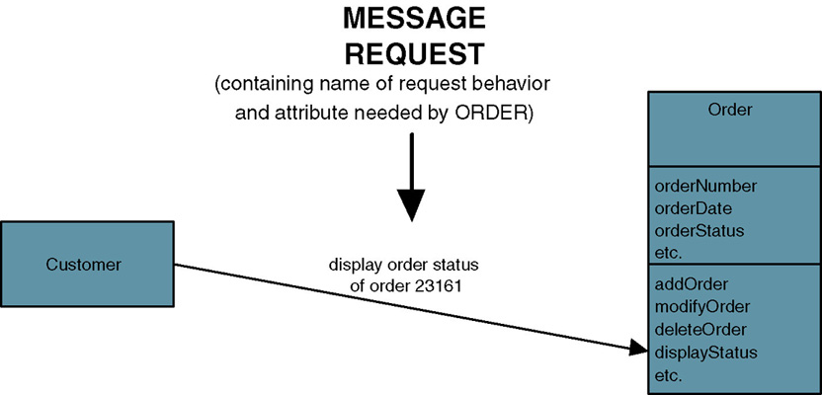
Messages
Message – communication that occurs when one object invokes another object’s method (behavior) to request information or some action

Slide 17
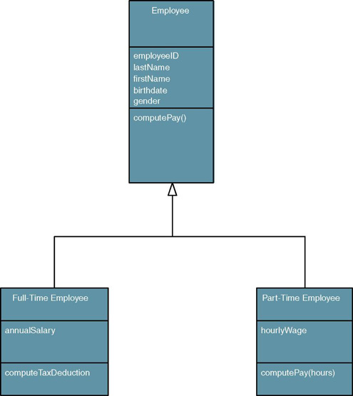
Polymorphism
Polymorphism – the concept that different objects can respond to the same message in different ways.
Override – a technique whereby a subclass (subtype) uses an attribute or behavior of its own instead of an attribute or behavior inherited from the class (supertype).

Slide 18
UML 2.0 Diagrams
Diagram | Description
Use Case | Depicts interactions between the system and external systems and users. In other words it graphically describes who will use the system and in what ways the user expects to interact with the system. The use-case narrative is used in addition to textually describe the sequence of steps of each interaction.
Activity | Depicts sequential flow of activities of a use case or business process. It can also be used to model logic with the system.
Class | Depicts the system's object structure. It shows object classes that the system is composed of as well as the relationships between those object classes.
Object | Similar to a class diagram, but instead of depicting object classes, it models actual object instances with current attribute values. The object diagram provides the developer with a "snapshot" of the system's object at one point in time.
State Machine | Models how events can change the state of an object over its lifetime, showing both the various states that an object can assume and the transitions between those states.
Composite Structure | Decomposes internal structure of class, component, or use case.

Slide 19
UML 2.0 Diagrams (cont.)
Diagram | Description
Sequence | Graphically depicts how objects interact with each other via messages in the execution of a use case or operation. It illustrates how messages are sent and received between objects and in what sequence.
Communication | (Collaboration diagram in UML 1.X) Depicts interaction of objects via messages. While a sequence diagram focuses on the timing or sequence of messages, a communication diagram focuses on the structural organization of objects in a network format.
Interaction Overview | Combines features of sequence and activity diagrams to show how objects interact within each activity of a use case.
Timing | Another interaction diagram that focuses on timing constraints in the changing state of a single object or group of objects. Especially useful when designing embedded software for devices.
Component | Depicts the organization of programming code divided into components and how the components interact.
Deployment | Depicts the configuration of software components within the physical architecture of the system's hardware "nodes."
Package | Depicts how classes or other UML constructs are organized into packages (corresponding to Java packages or C++ and .NET namespaces) and the dependencies of those packages.

Slide 20
The Process of Object Modeling
Modeling the functions of the system.
Finding and identifying the business objects.
Organizing the objects and identifying their relationships.

Slide 21
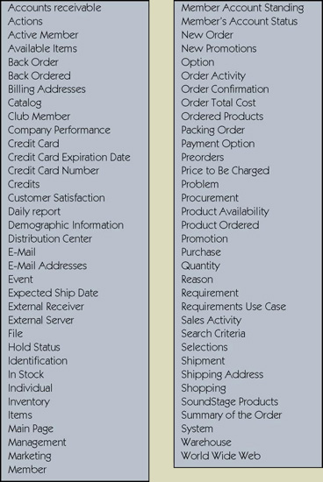
Potential Object List

Slide 22
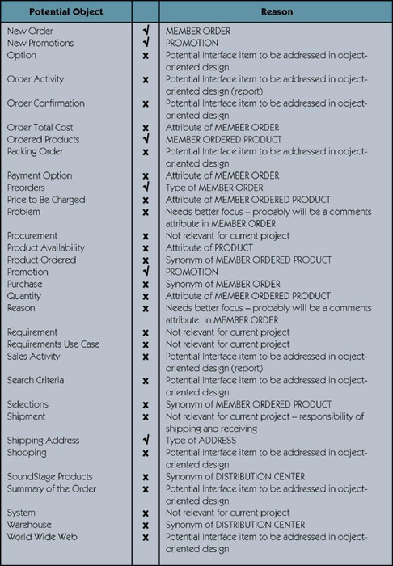
Cleaning Up List of
Candidate Objects

Slide 23
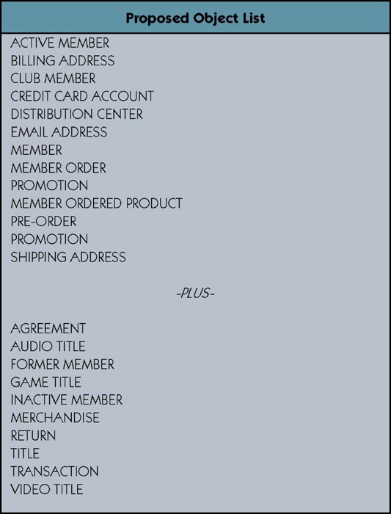
Proposed Object List

Slide 24
Organizing the Objects and Identifying their Relationships
Identifying Associations and Multiplicity
Identifying Generalization/Specialization Relationships
Identifying Aggregation Relationships
Prepare the Class Diagram
Class diagram – a graphical depiction of a system’s static object structure, showing object classes that the system is composed of as well as the relationships between those object classes.

Slide 25
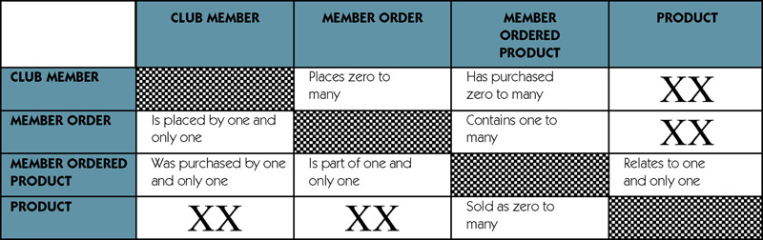
Object Association Matrix

Slide 26
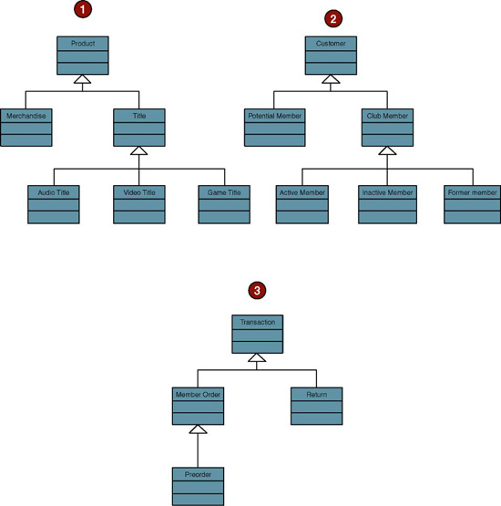
Generalization/Specialization Hierarchies

Slide 27
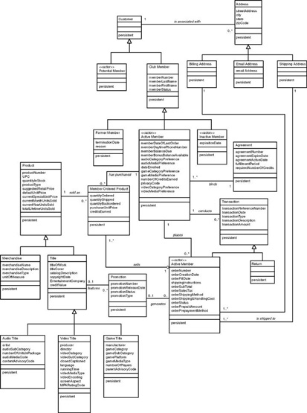
Class Diagram

